Slide 1
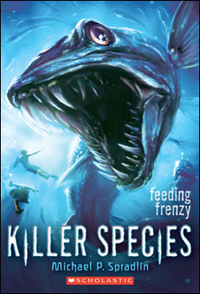
Killer Species
Author: Michael P. Spradlin
Main Characters: Dr. Catalyst, Emment, Calvin and Dr.Geaux
Main Setting: underwater/beaches
By: Alyssa Jennings

Slide 2
Dr. Catalysts
Emment and Calvin think that Dr. Catalysts is dead because Dr. Catalysts wanted to go invent under water animals. So he went somewhere that no one will find him creating this monsters.

Slide 3
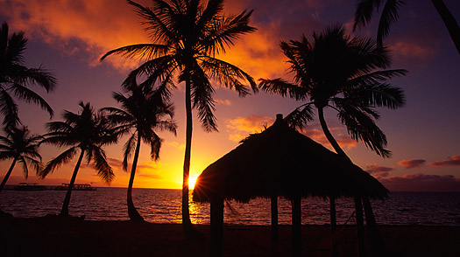
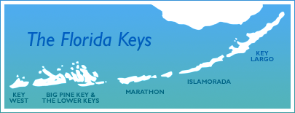
Florida Keys
Emment, Calvin and Emment’s dad go to The Florida Keys because Emment’s dad is called from home saying that he needs to go assist Dr. Geaux. (Emmet’s dad is a scientist)

Slide 4
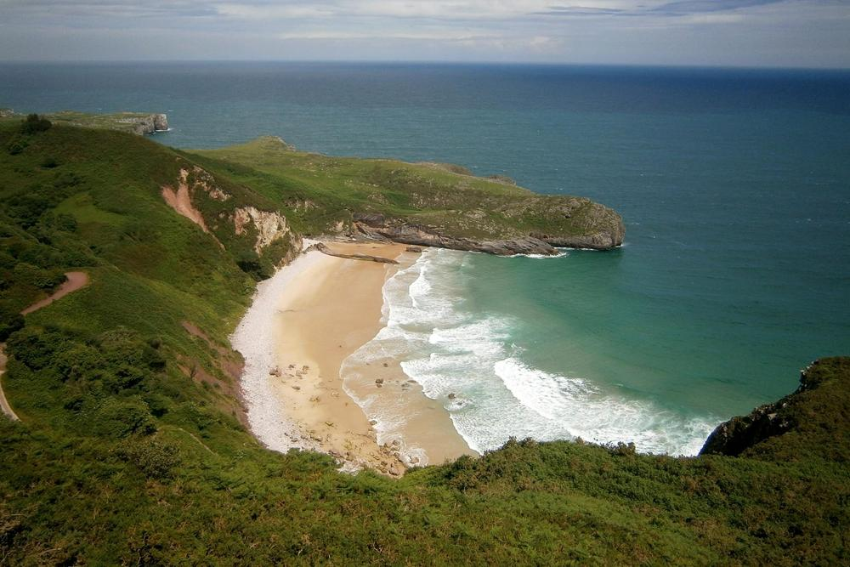
Drowned
One of Emment and Calvin's friends almost drowned because some kind of monster grabbed him and started pulling him down so far into the river/ocean that he couldn’t breath any longer.

Slide 5
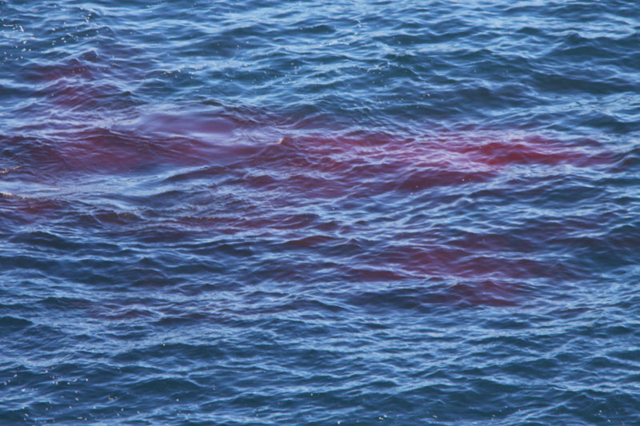
The attack
After the attack of the monster his friend had so much blood in the water from the bite the monster gave him. That meant the monster was trying to drown him so he could eat him.
(Blood in water☹)

Slide 6
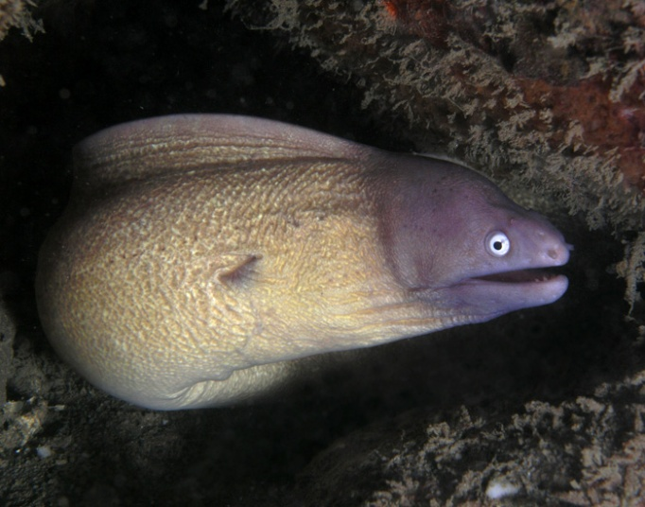
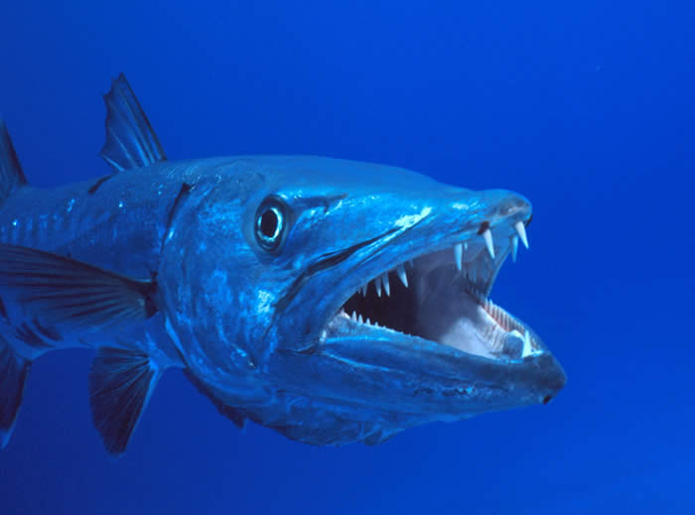
What people think the monster is
Some people think the monster is some kind of Moray Eel or a giant Barracuda, but the people haven't figured it out yet. Even the smartest scientist have no idea what this monster is. Also, Emment and his friends think that the monster has “endless rows of razor sharp teeth.”
(Moray Eel)
(Barracuda)

Slide 7
The Scientist
Emment thinks that the Scientist Dr. Catalysts is not dead because he could have come back for revenged for what happened to him. I think what Emment is trying to say is that Dr. Catalysts is hiding somewhere where no one will find him doing all of this monster stuff.

Slide 8
Dr.Geaux
Dr. Geaux (Dr. Geaux is Emment’s dad’s boss) helps Emment and his friends try to find out what kind of monster this is and who is controlling it.

Slide 9
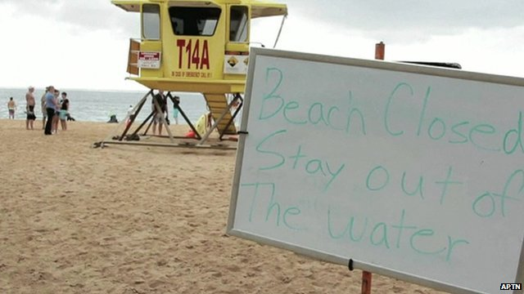
Dr. Catalysts
One day Dr. Catalysts was all over the news trying to warn people not to go to the beaches because of the monster. In my opinion I think he is trying to warn them so people don't suspect that he is the one controlling the monster. So he warns every kid and adult to stay away from the beaches.

Slide 10
Extra information
“Dr. Catalyst, has a plan to combat these animals. He's going to create his own genetically altered super predators to halt the spread of the invaders.”
“Dr. Geaux, the Everglades National Park Superintendent, to find out why birds and other animals are migrating out of the Everglades in record numbers. What he discovers is shocking. Someone is releasing genetically engineered animals into the Florida wilds.”
“Dr. Catalyst is a scientist that is experimenting on creating underwater animals.”

Slide 11
Find out what happens!!!!!!!!!!!

Slide 12
THE END!!!! ☺

